Slide 1
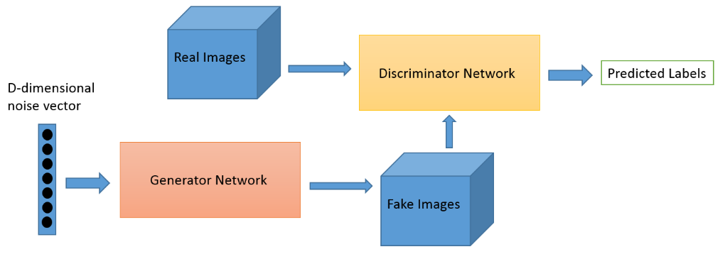
Feedback
Feedback

